Slide 1
Exploring Data Science Job Market
Leila

Slide 2
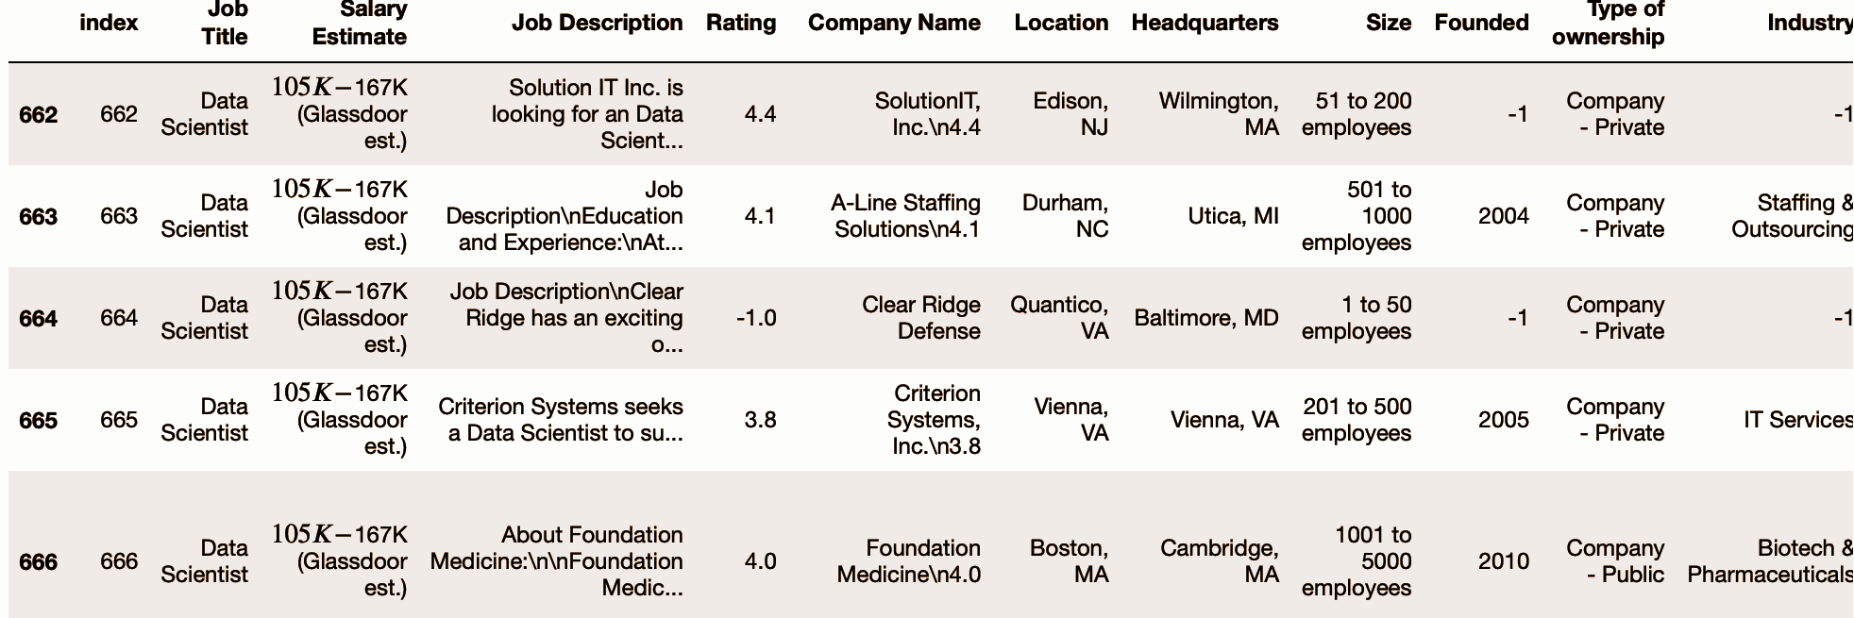
Introduction
Data science job postings from Glassdoor.
The primary goal is to gain insights into the job market for data science roles and provide valuable information for job seekers, companies, and policymakers.

Slide 3
Hypotheses
Certain industries like technology, finance, and healthcare will exhibit higher demand for data science roles.
Larger companies and higher revenue organizations are likely to offer higher salary ranges for data science positions, and certain geographic regions will have a higher prevalence of open data science positions.

Slide 4
Research questions
Which industries or sectors have high demand for data science roles, and what are the most common job titles required?
Do company size and revenue levels influence salary estimations among the companies in the dataset?
Are there geographic regions where the open positions are more prevalent?

Slide 5
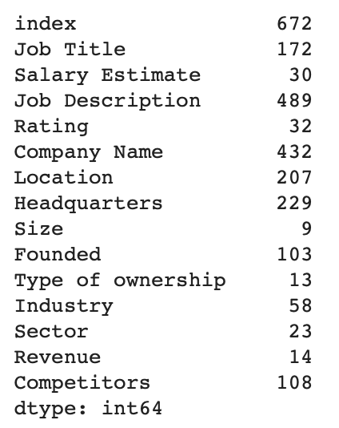
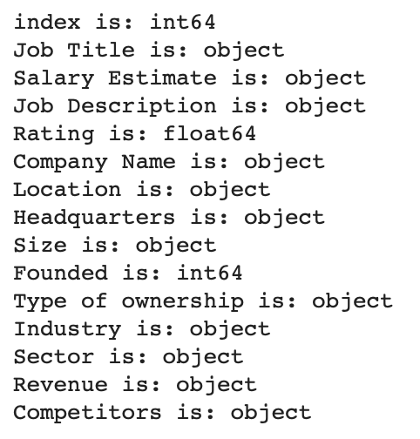
Initial Analysis
Relevant Data Quality Issues
Inconsistent Naming Conventions
Variability in Terminology
Special Characters and Numbers
Potential Errors/Non-Relevant
Placeholder Values: '-1'
String values

Slide 6
Data cleaning
strategies
Identifying key characteristics
Utilizing methods like regular expressions and tailored functions
patterning and reducing unique values
Removing inconsistencies, addressing missing or irrelevant information

Slide 7
Codes review

Slide 8
Data Analysis
Certain industries like technology, finance, and healthcare will exhibit higher demand for data science roles.
Larger companies and higher revenue organizations are likely to offer higher salary ranges for data science positions, and certain geographic regions will have a higher prevalence of open data science positions.

Slide 9
Which industries or sectors have a high demand for data science roles, and what are the most common job titles required?

Slide 10
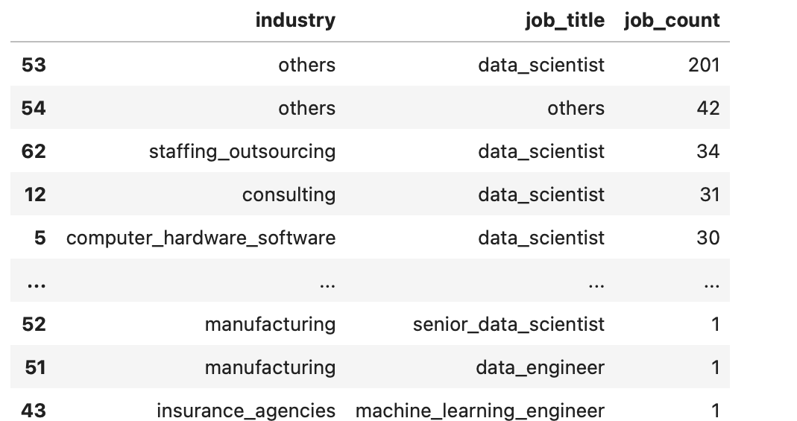
To gain a clearer understanding of the true distribution of industries and the job titles -> filtering and excluding irrelevant or uncategorizable data

Slide 11
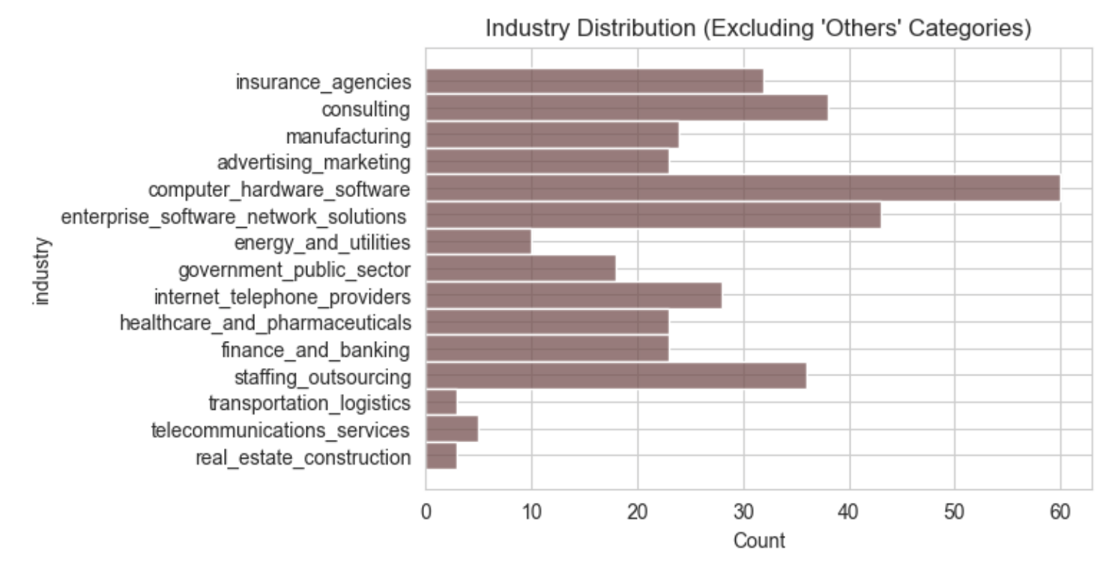

Slide 12
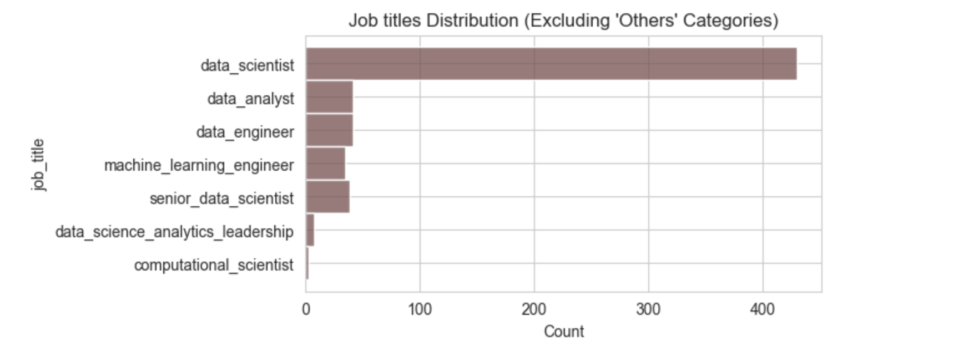

Slide 13
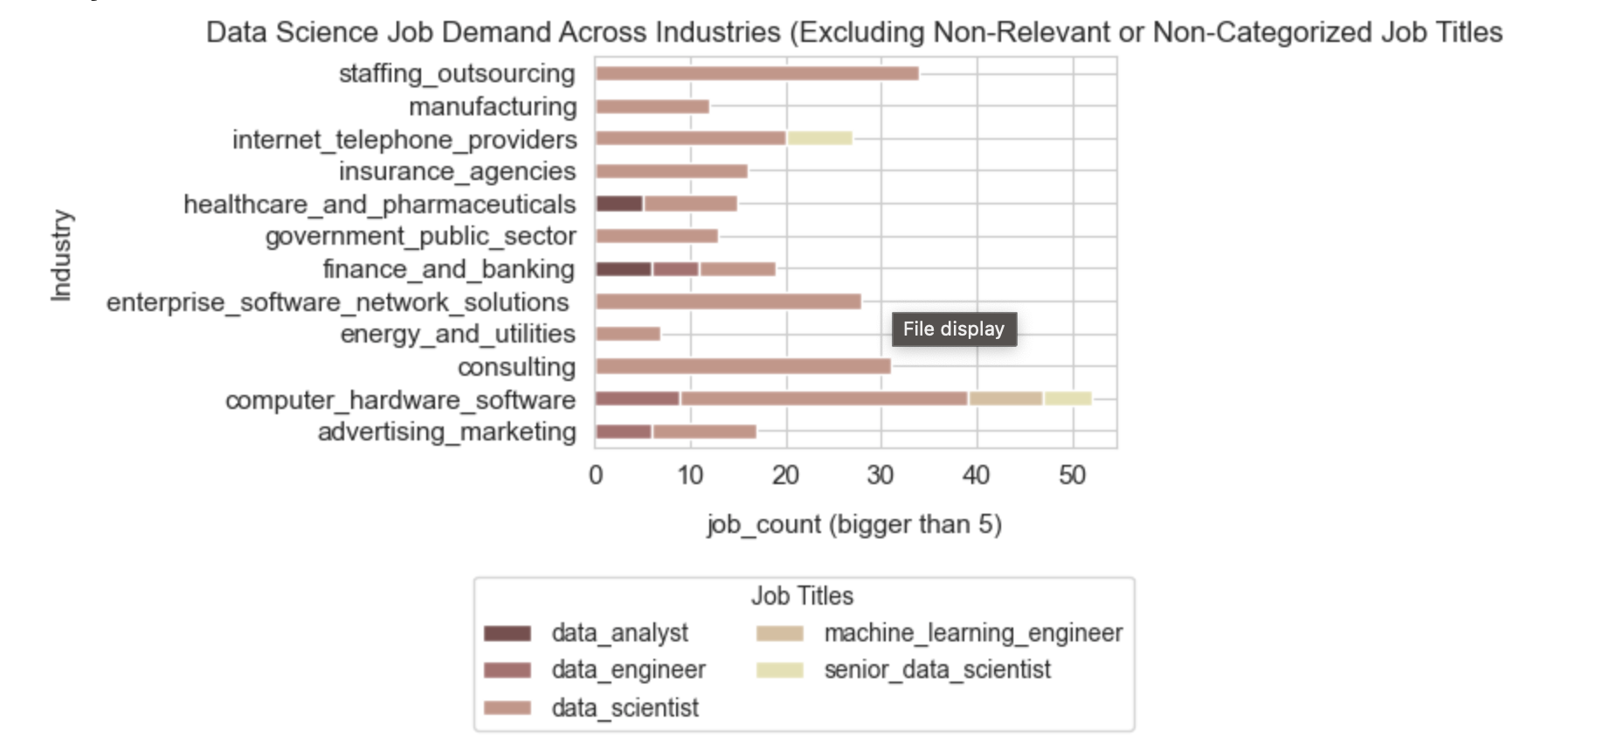

Slide 14
Do company size and revenue levels influence salary estimations among the companies in the dataset?

Slide 15
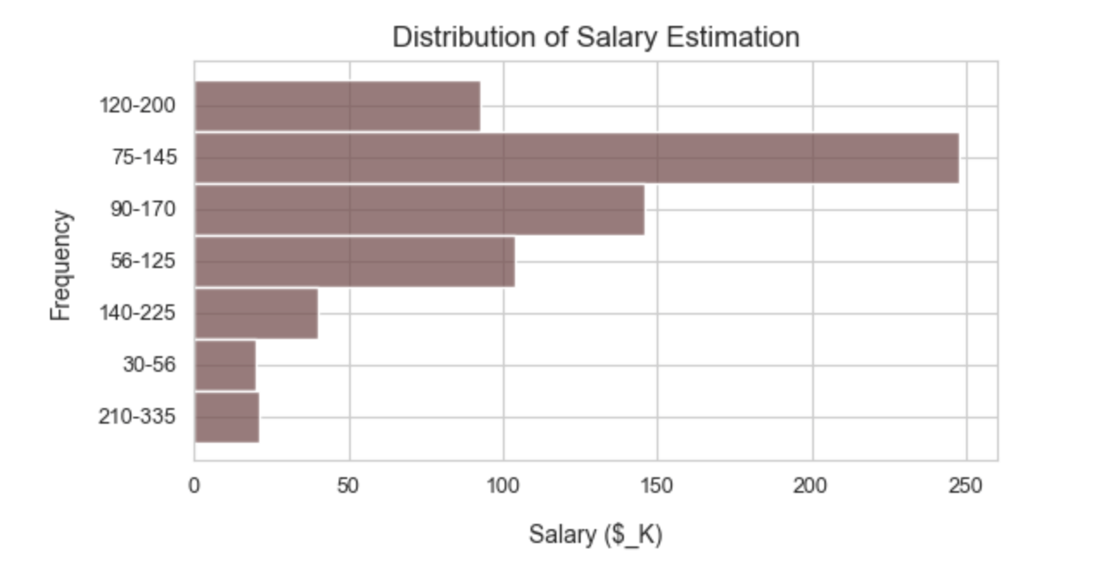

Slide 16
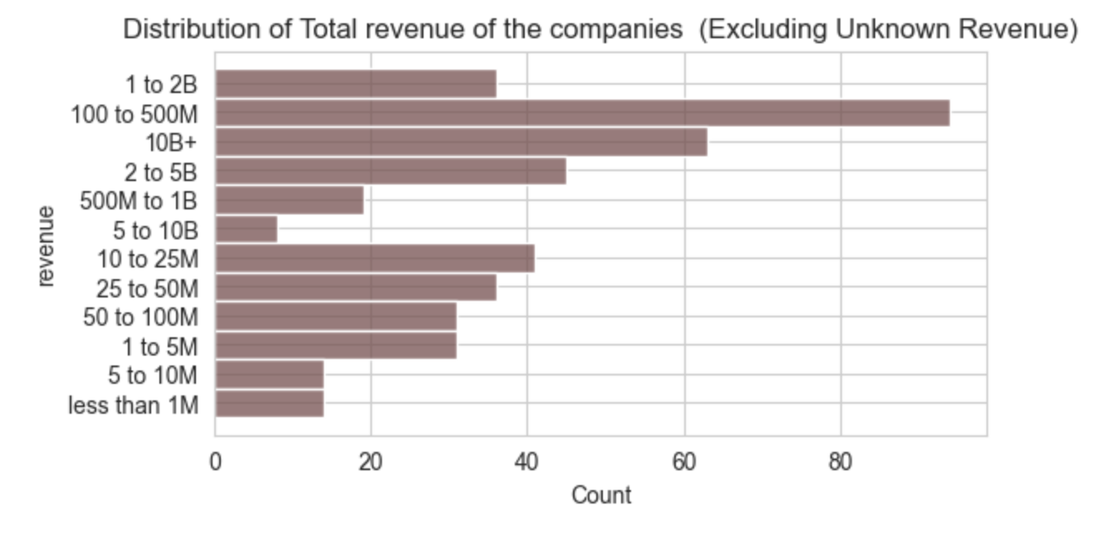

Slide 17
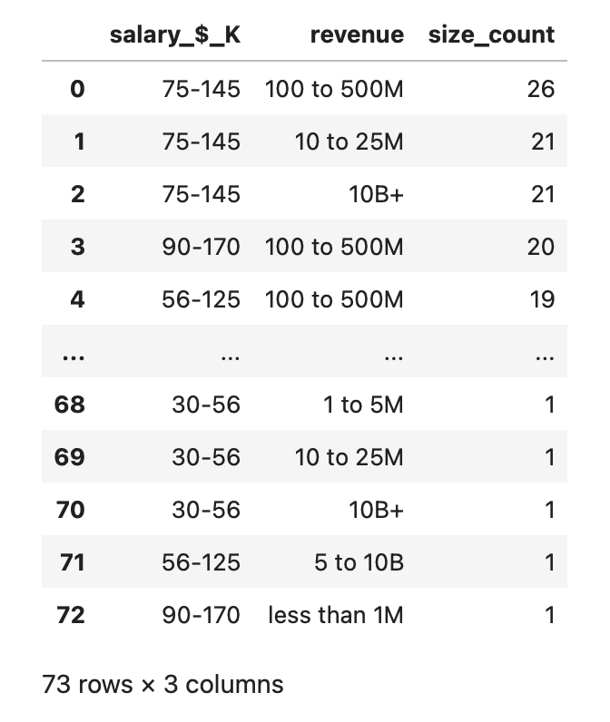
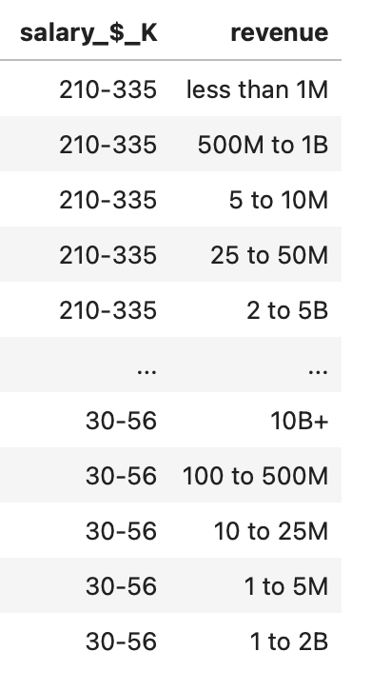

Slide 18
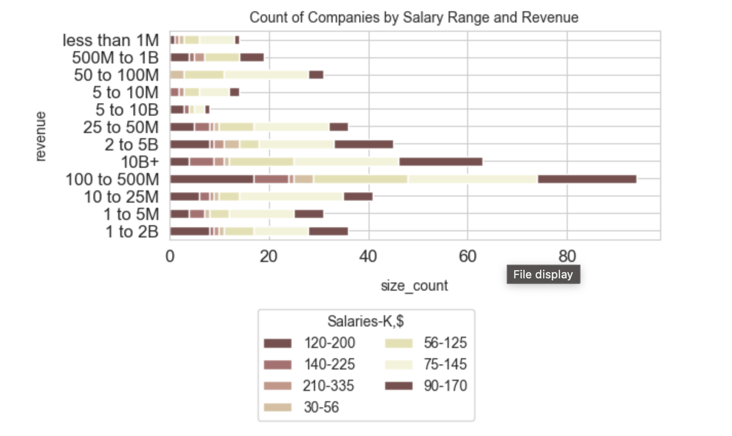

Slide 19
Are there geographic regions where the open positions are more prevalent?

Slide 20
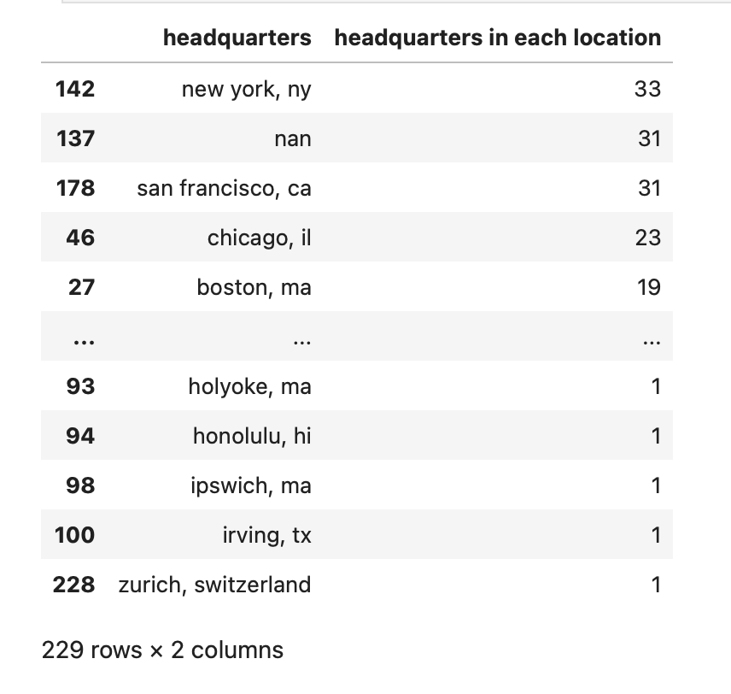
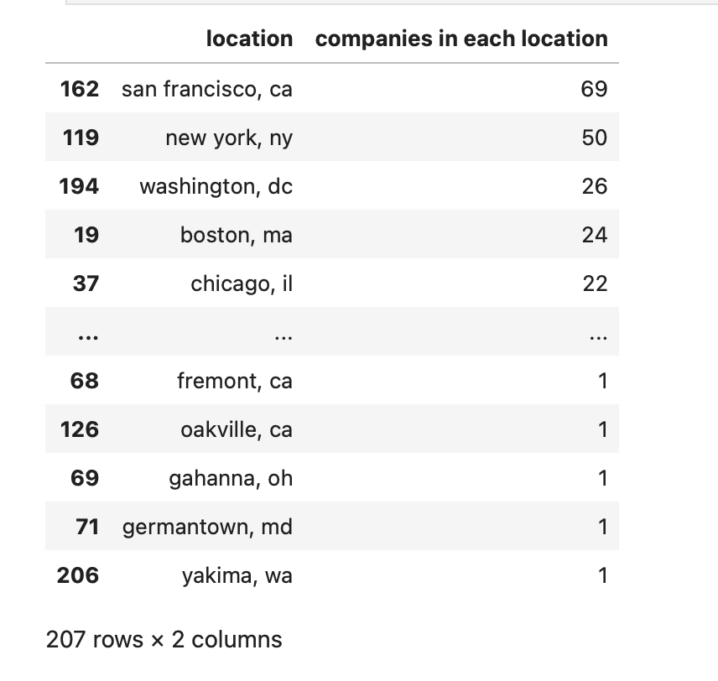

Slide 21
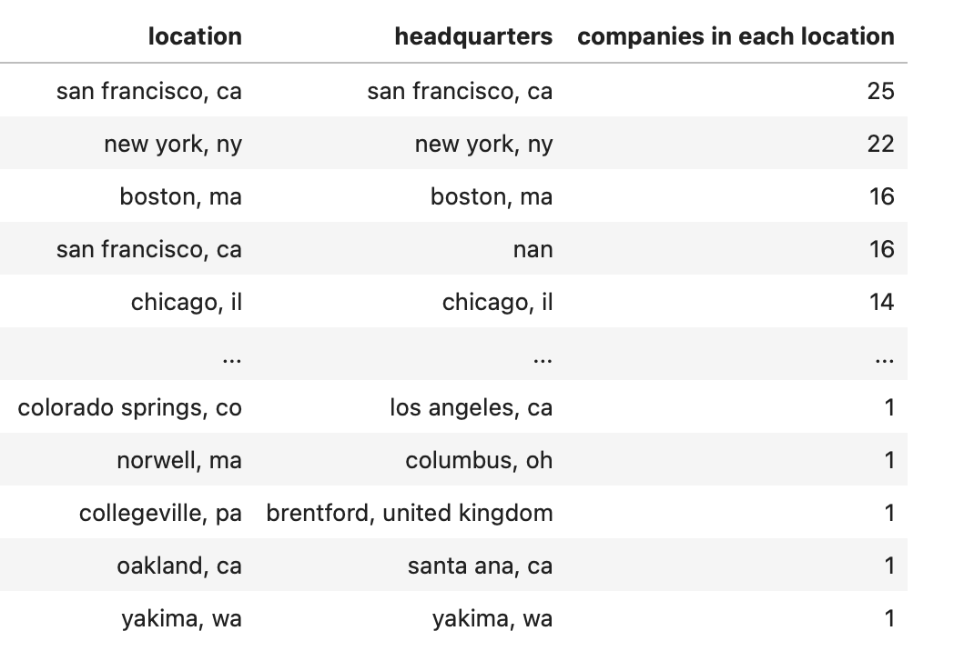

Slide 22
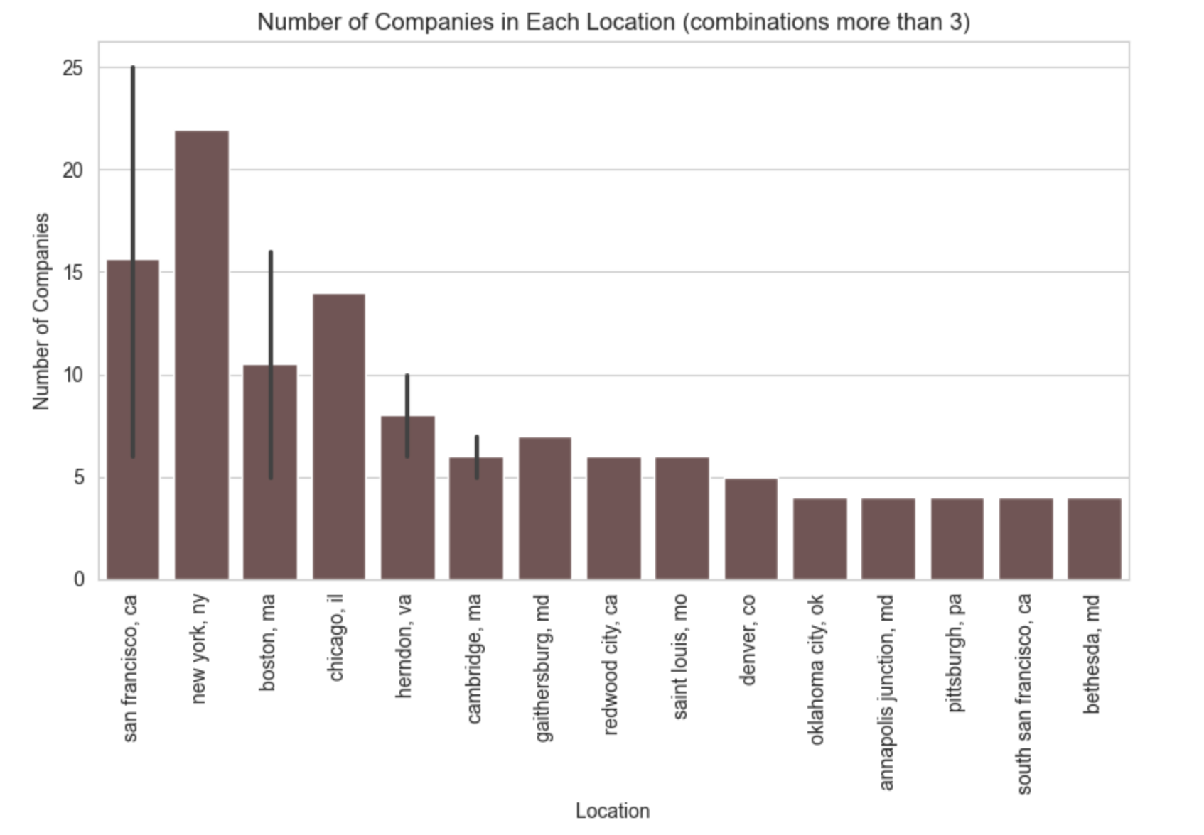

Slide 23
Conclusion
High Demand Industries and Job Titles: Industries such as 'Computer Hardware & Software', 'Enterprise Software & Network Solutions', and 'Consulting' have a high demand. The most common job titles required include 'Data Scientist',next 'Data Analyst', and 'Data Engineer', with staffing and outsourcing firms exhibiting the highest demand for data scientists.
Impact of Company Size and Revenue on Salary Estimations: The distribution of salaries reveals that the range of 75-145K is the most prevalent, indicating significant demand within this range across different revenue categories. Salary ranges at the extremes, such as 30-56K and 210-335K, show limited demand. While there may be some influence between salary and revenue, both factors should be considered independently.
Prevalence of Open Positions in Geographic Regions: Major cities like San Francisco, CA, New York, NY, and Boston, MA, emerge as prominent centers for open positions. variations in the distribution of headquarters indicate diverse organizational structures and strategic decisions.

Slide 24
Thank you!
Next Steps
Explore additional datasets to further analyze the job market dynamics, such as trends over time,or regional variations.
Influence of geographical regions on salaries
Conduct more in-depth analysis on specific aspects, such as the relationship between job satisfaction and salary, the impact of education level on job opportunities, or the demand for specific skills.
Build predictive models based on the findings to forecast future job market trends and provide actionable insights for job seekers and companies.

